Slide 1

Beijing Air Quality Analysis
Visual | Data + Storytelling
Includes descriptive analytics, station comparison, and correlations.
Enhanced with custom thematic visuals for stronger storytelling.

Slide 2
Analysis Framework
From raw data to actionable insights
Data Quality: missing values and consistency checks
Descriptive Layer: distribution, trend, and outliers
Spatial Layer: station-level exposure differences
Relationship Layer: pollutant and weather correlations

Slide 3
Dataset Overview
Records used: 412,029
Stations covered: 12
Time range: 2013-03-01 to 2017-02-28
Key variables: PM2.5, PM10, SO2, NO2, CO, O3
Data files loaded: 12

Slide 4
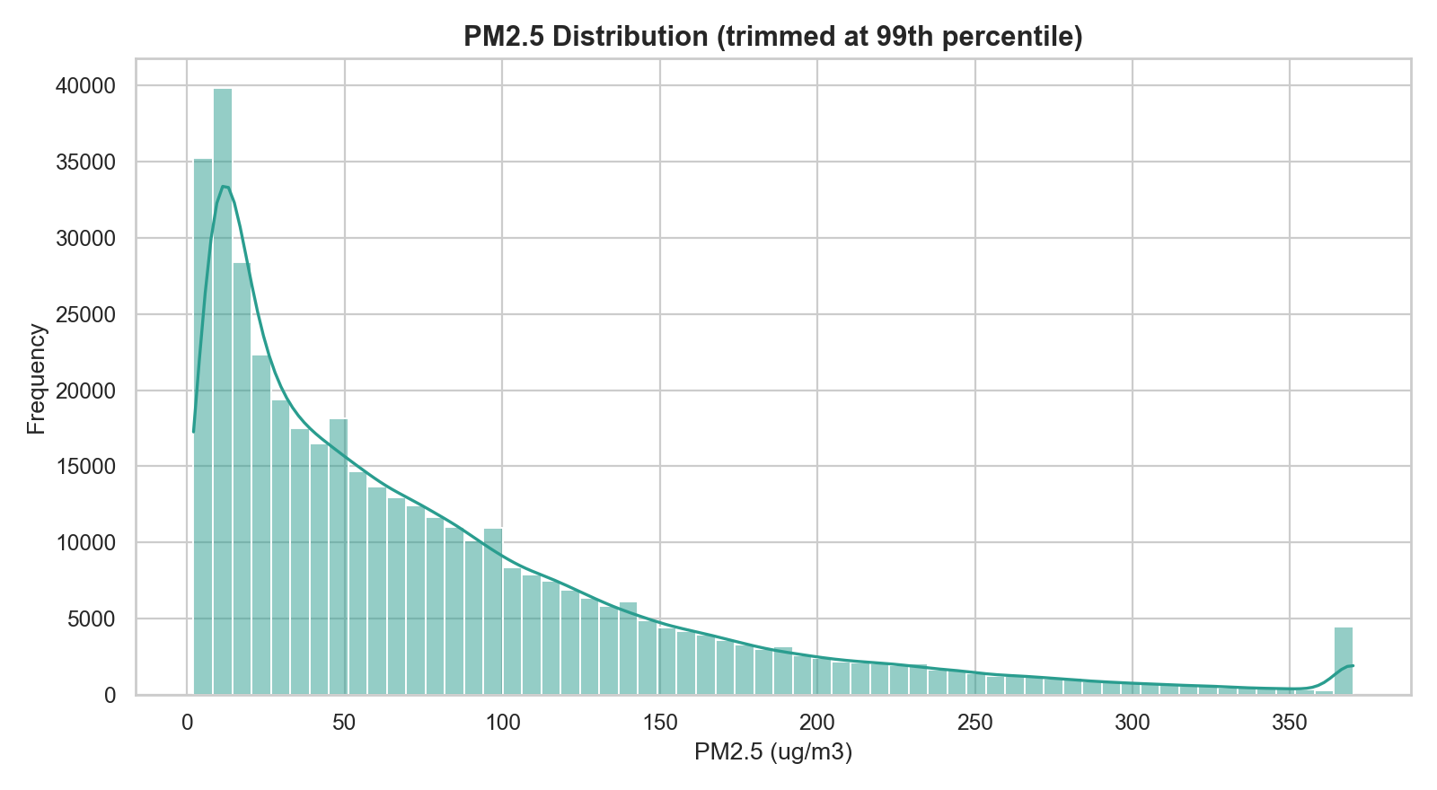
PM2.5 Distribution
Mean: 79.79 | Median: 55.00
Right-skewed distribution indicates episodic high-pollution events.
Most observations cluster at lower-to-mid concentration levels.

Slide 5
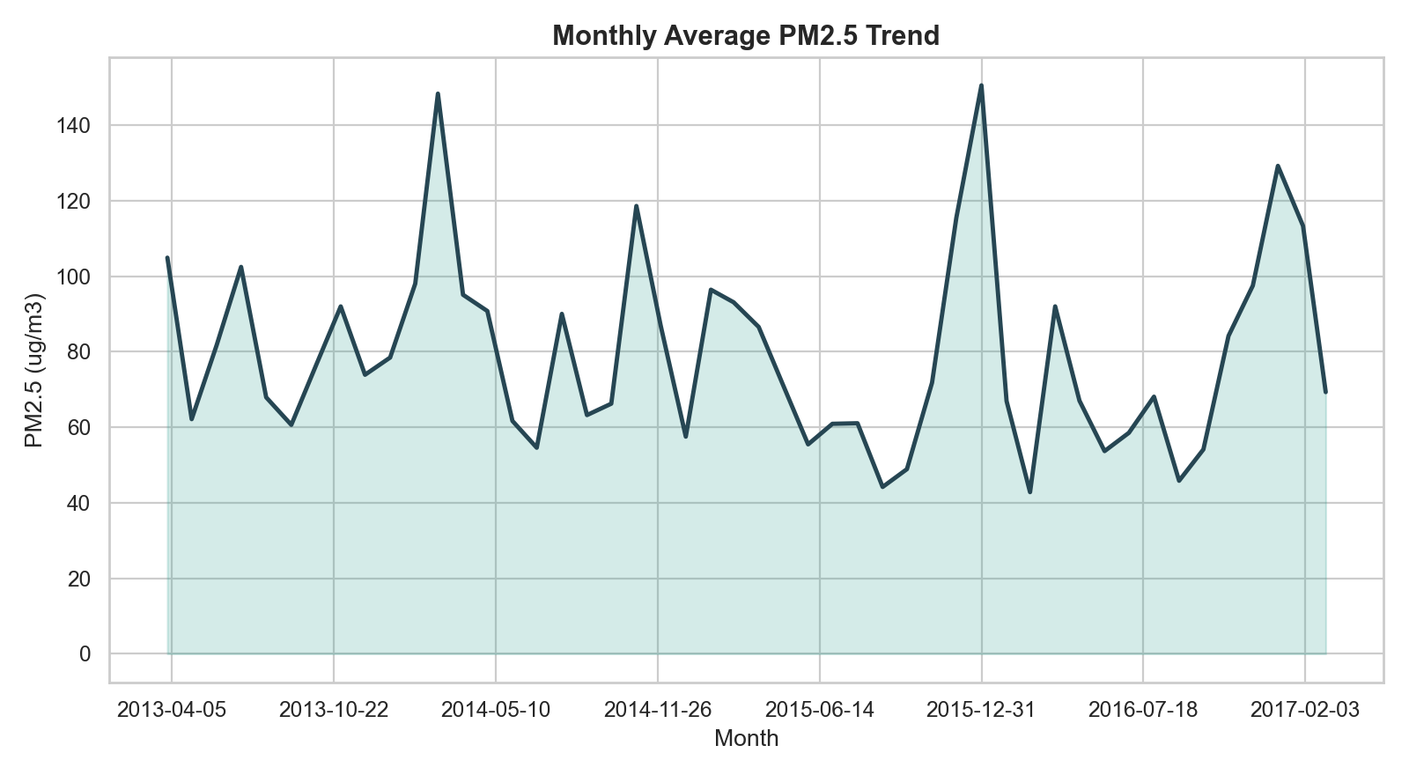
Monthly PM2.5 Trend
Clear month-to-month volatility over the observed period.
Seasonal behavior suggests stronger winter pollution pressure.
Trend monitoring supports policy timing and early warning.

Slide 6
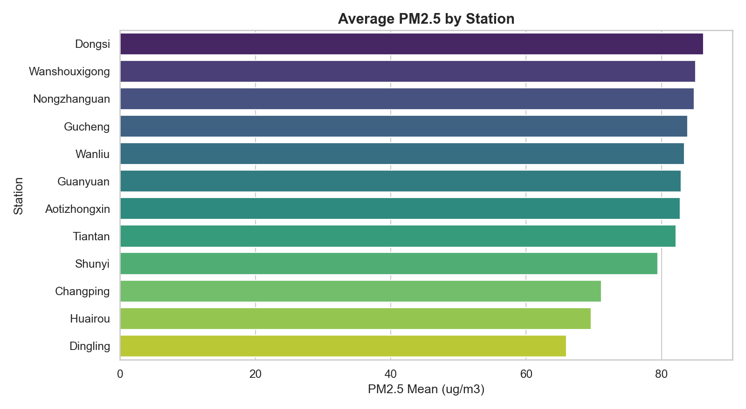
Station Comparison (PM2.5 Mean)
Highest station:
Dongsi (86.2)
Lowest station:
Dingling (66.0)
Spatial inequality
Supports zone-based
management strategies.

Slide 7
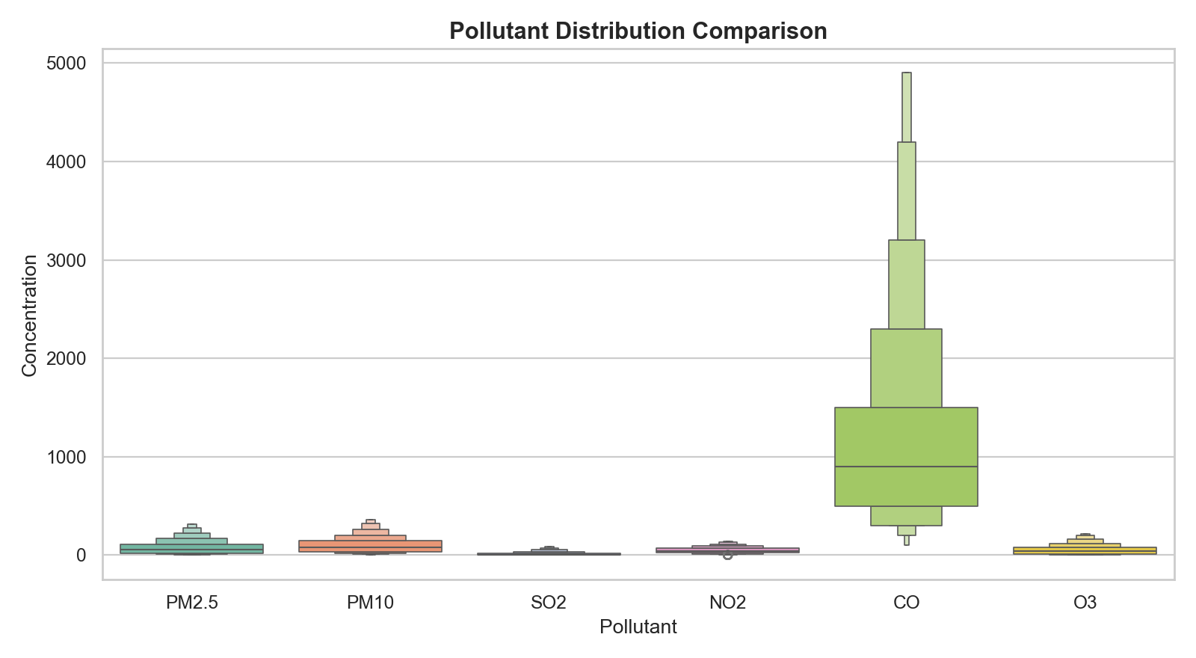
Pollutant Spread Comparison
Different pollutants show distinct spread and outlier behavior.
High-dispersion indicators require tighter operational monitoring.
Outliers likely correspond to extreme local pollution episodes.

Slide 8
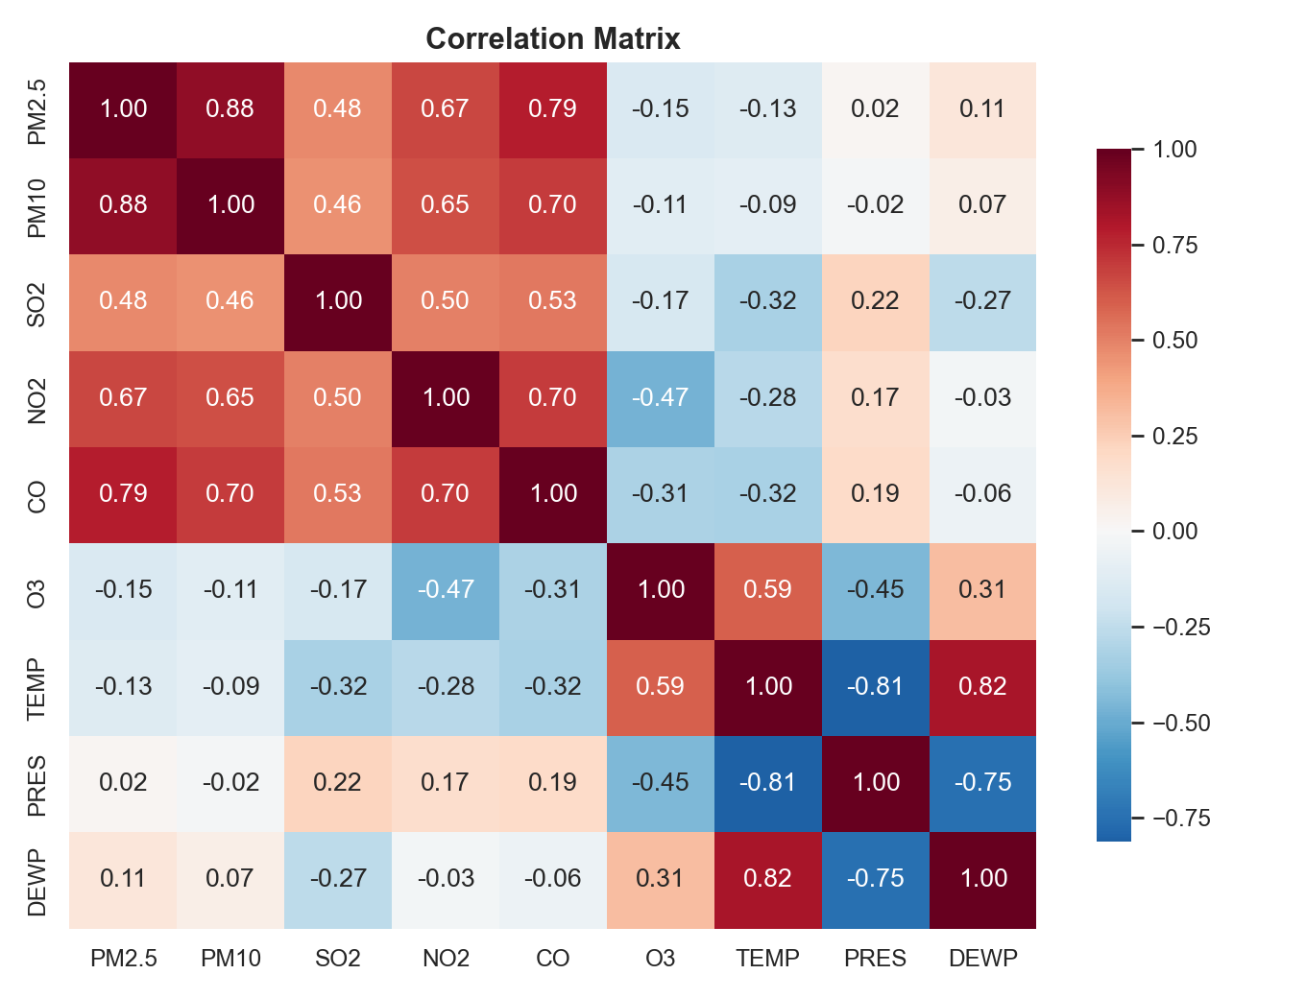
Correlation Heatmap
Key PM2.5 relationships: PM10: 0.88, CO: 0.78, NO2: 0.66
Strong positive links imply shared sources or co-movement effects.
Correlation findings can guide predictive feature selection.

Slide 9

Conclusions & Recommendations
Air pollution is both spatially and temporally heterogeneous.
PM2.5 mitigation should be coordinated with PM10/CO controls.
Season-focused and station-specific interventions are recommended.
Next: integrate full-site data and build forecasting models.

